Slide 1
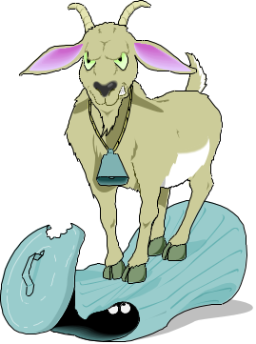
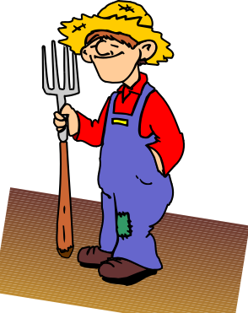
Gilbert is a goat and he likes eating grass
The farmer keeps him in a rectangular field measuring 10 metres by 8 metres.
In each of the following cases construct an accurate diagram to show the area of grass that Gilbert can munch on.

Slide 2
Gilbert is tethered to the corner of the field by a 6 metre long rope

Slide 3
Gilbert is tethered to the midpoint of the longer side of the field by a 7 metre long rope

Slide 4
Gilbert is tethered to the shorter side of the field, 2 metres from the corner, by a 5 metre long rope

Slide 5
Gilbert is tethered to the centre of the field by a 3 metre long rope

Slide 6
The farmer mistakenly tethers Gilbert to the outside corner of the field using a 4.5 metre long rope

Slide 7
The farmer mistakenly tethers Gilbert to the outside corner of the field using a 5 metre long rope

Slide 8
The farmer tethers Gilbert outside the field, to a point 3 metres along from the corner on the longer side. The farmer uses a 5 metre long rope
(Try this one out – it’s an interesting solution!)

Slide 9
For some reason known only to him, the farmer fixes a 2 metre long pole along the centre of the field. Gilbert is tethered to this horizontal pole so that his (2 metre long) rope can slide along it.

